Slide 1
The Legacy of the Outer Space Treaty
Gérard Brachet
Space Policy Consultant
Founder and CEO of Spot Image (1982-1994)
Director General CNES (1997-2002)
Chairman, UN COPUOS (2006-2008)
Paris, France

Slide 2
The Legacy of the Outer Space Treaty
Let us start from historical evidence:
During the Cold War, both the United States and the Soviet Union considered Outer Space as a strategic high ground
Strong link between nuclear deterrence and space capability (surveillance, targeting)
Priority is to prevent a surprise attack

Slide 3
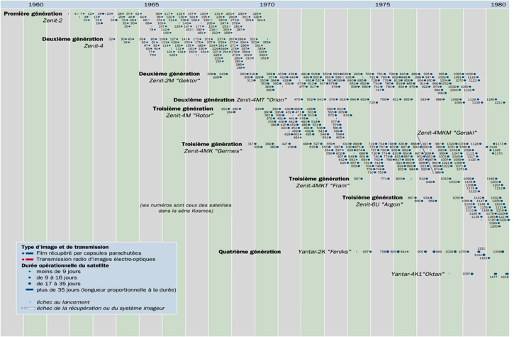
The Legacy of the Outer Space Treaty
Observation satellites - Soviet Union (1960-1980)

Slide 4
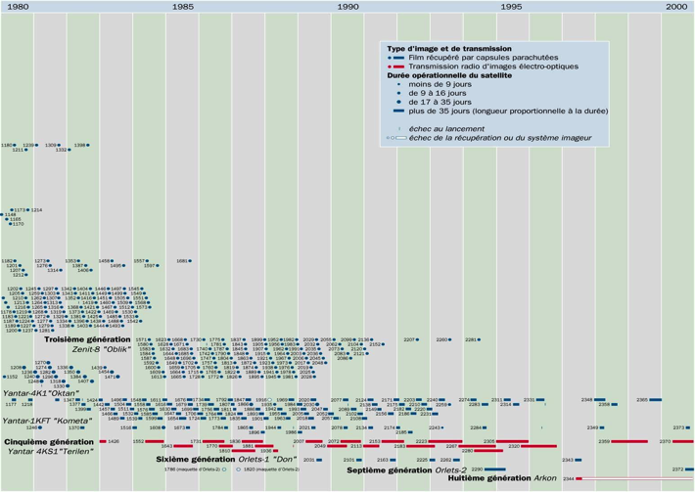
The Legacy of the Outer Space Treaty
Observation Soviet Union - Russia (1980-2000)

Slide 5
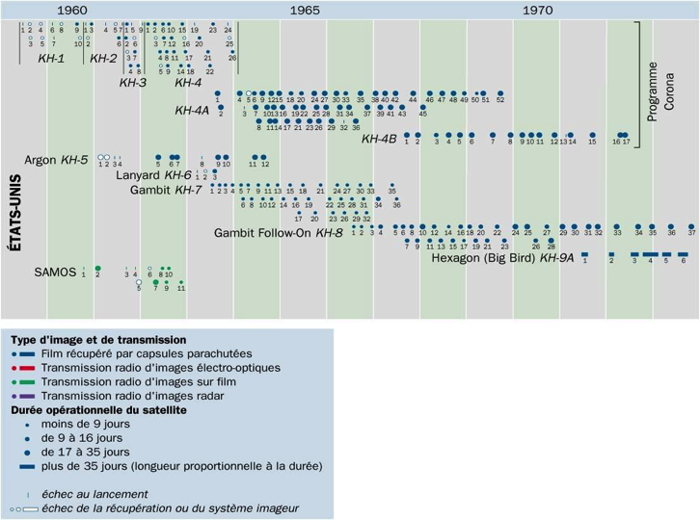
The Legacy of the Outer Space Treaty
Observation satellites - U.S (1960-1980)

Slide 6
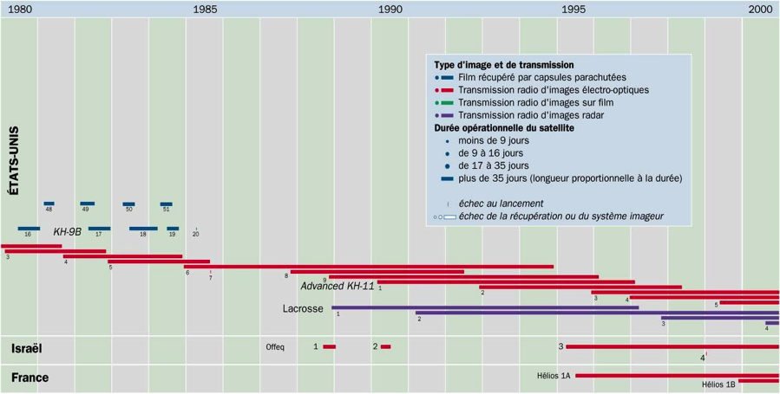
The Legacy of the Outer Space Treaty
Observation satellites - U.S. (1980- 2000)

Slide 7
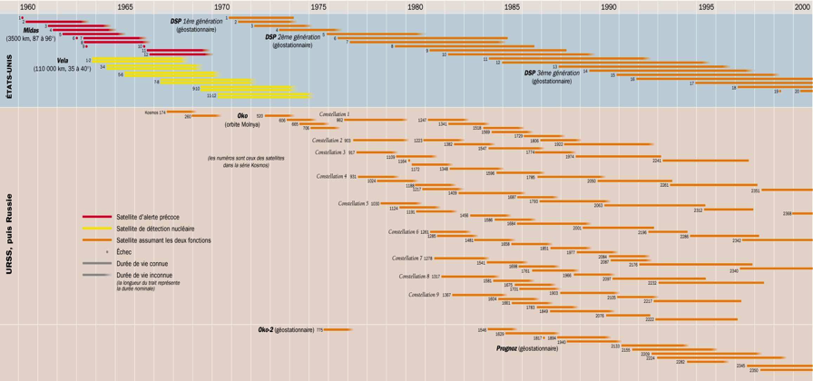
The Legacy of the Outer Space Treaty
Early warning satellites – US and USSR

Slide 8
The Legacy of the Outer Space Treaty
The two super powers had a vested interest in keeping outer space free of restrictions which might limit its use.
In addition, the international scientific community pushed for a wide access to outer space as a base for exploration.

Slide 9
The Legacy of the Outer Space Treaty
Hence the basic principles contained in the Outer Space Treaty of 1967:
. No national appropriation
. Equal access (in principle) to all nations
. Freedom of circulation
. Freedom of data collection
. No deployment of weapons of mass destruction (military activities are forbidden on the Moon and other celestial bodies)
. States are responsible for activities in outer space conducted by their nationals, governmental or not.

Slide 10
The Legacy of the Outer Space Treaty
These principles have been successfully supported over the years by all space-faring nations.
Today, 105 States have ratified the OST.
However, some states who own and operate satellites have not ratified the OST (e.g. Columbia).
Nine countries and one regional grouping have an orbital launch capability, but only six of them launch spacecraft regularly :
. China
. Europe (ESA)
. India
. Iran
. Israel
. Japan
. South Korea
. North Korea
. Russia
. United States
In addition, many private launch operators are now on the market. They will probably extend this list in the near future.

Slide 11
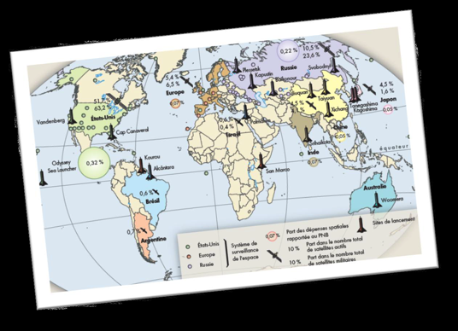
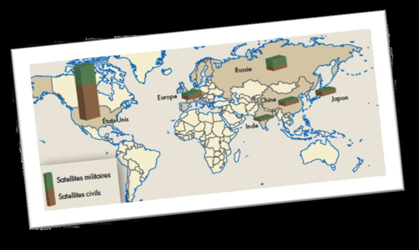
The Legacy of the Outer Space Treaty
50 years later
Satellite launch bases and capability
Civil and military Satellites in operation

Slide 12
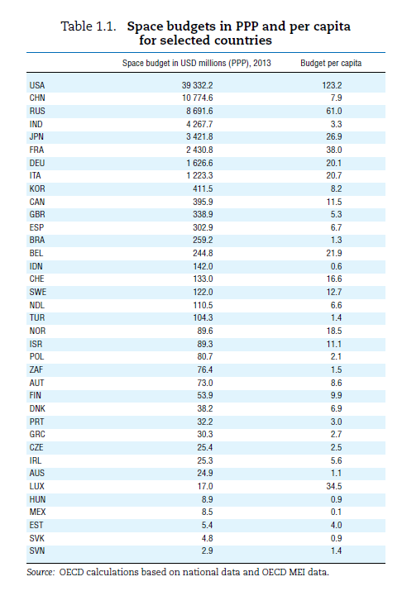
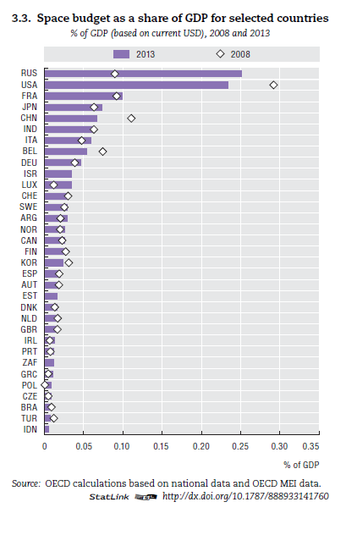
The Legacy of the Outer Space Treaty
In 2017, sixty countries have at least one satellite in orbit
Space budgets in 2013 (OECD)

Slide 13
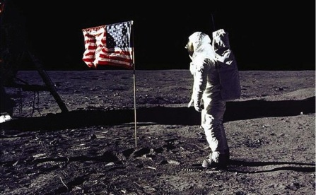
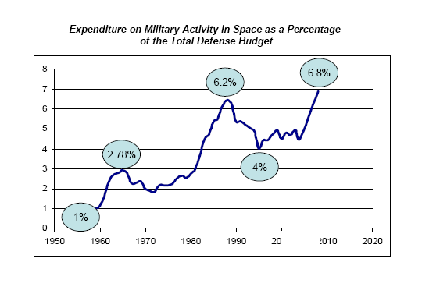
The Legacy of the Outer Space Treaty
The US continues to dominate and its space expenditure is by far the largest, not only its civilian, NASA-led programme,
… but its military space program is very extensive and represents probably more than half of the world’s expenditure in military space!

Slide 14
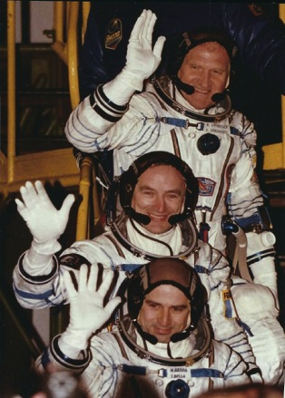
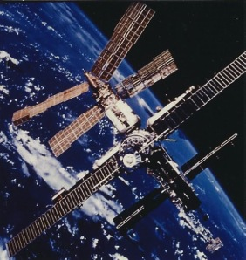
The Legacy of the Outer Space Treaty
Russia is trying hard to rebuild its space capability in order to become a great player again, building on its vast experience
and its industrial base.
However, the
Russian
government’s
priority is clearly
its military space
capability and its
civilian programme
is suffering.
The Mir Russian Space Station

Slide 15
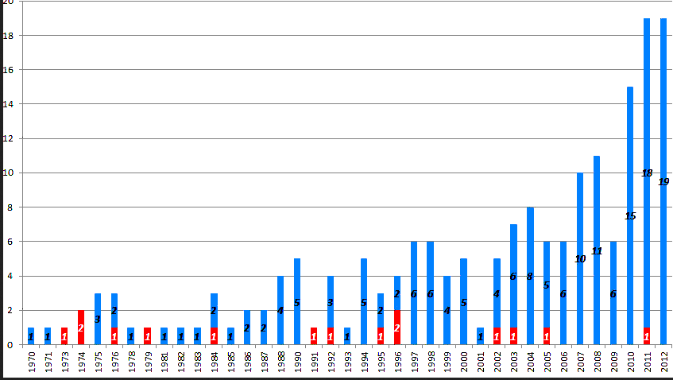
The Legacy of the Outer Space Treaty
China has become a very significant player and is not hiding its ambition to become a world leader.
An official China’s Space Policy is published and regularly updated. Its manned space program is developing steadily but with caution.
However,
lack of
transparency
remains a
major
problem.
Lancements chinois de 1970 à 2012

Slide 16
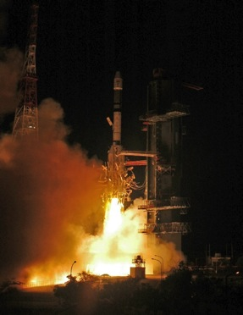
The Legacy of the Outer Space Treaty
India has been a very active space power for a long time and has a very dynamic programme.
Very application-oriented for many years, it has recently been extended to include space exploration.
India operates its own,
very reliable,
polar orbiting launch
capability (PSLV)
and sell launch
services successfully
on the world market.

Slide 17
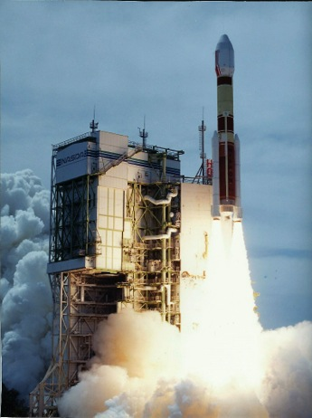
The Legacy of the Outer Space Treaty
Japan is also a major space actor, with a very strong science community and successful space science projects.
It has its own very reliable
launcher (H2B) but has found
it difficult to commercialize
it on the world market.
Japan’s military space assets
(Intelligence Gathering Satellites-
IGS) have developed significantly
over the last ten years
in reaction to the political
situation in east Asia.
HIA launcher -Tanegashima
17 August 1996

Slide 18
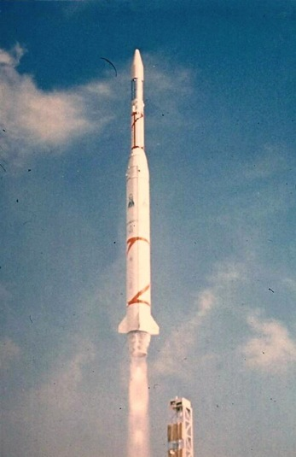
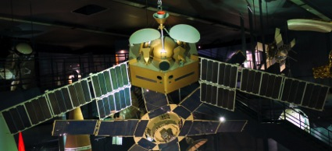
The Legacy of the Outer Space Treaty
In Europe, space activities started in the 1960s, mostly at the national level, and developed nicely in the 1970s within the ESA cooperative framework.
The Symphonie telecommunication satellites (Cooperation between France and Germany) 1974-1975
Launch of the French Diamant-A in December 1965

Slide 19
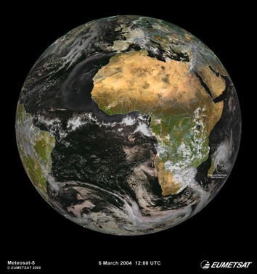
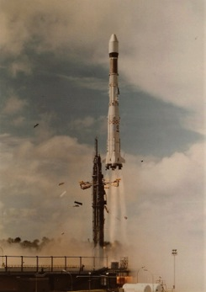
The Legacy of the Outer Space Treaty
Today, the European Union is trying to take over the traditional role played by the European Space Agency for civilian space programs.
This is only partially successful. The ESA cooperation model is considered by its member states as satisfactory. ESA continues to be the major player in Launcher developments and in Science and Exploration.
Lancement Ariane L01 -
24 décembre 1979
Image of the Earth disk from Meteosat, the first European meteorological satellite, launched in 1977, at zero degree longitude

Slide 20
The Legacy of the Outer Space Treaty
Thanks to the provisions of the OST, many other emerging and developing countries have become active space nations, mostly via the deployment of their own micro- or mini-satellites.
e.g. Thailand, South Korea, Indonesia, Malaysia, Singapore, Vietnam, Kazakhstan, UAE, Egypt, Algeria, Morocco, Nigeria, South Africa, Brazil, Argentina, Colombia, Chile, Peru, etc.

Slide 21
The Legacy of the Outer Space Treaty
All this was possible because the Outer Space Treaty and the other Conventions provided an adequate international legal framework.
If we try to analyse the motivations for governments to invest in space activities, one can identify three basic and interconnected motivations:
Security and Defense
Applications to society’s needs (which lead to commercial space activities)
Scientific research and Exploration

Slide 22
The Legacy of the Outer Space Treaty
1/ Security and Defense was the prime motivation for the US and the USSR during the cold war.
It is still today a major element of national space policy in many countries:
Space technology is very close to aerospace and missile technologies;
Mastering space systems is an indicator of states’ military and defense capabilities (e.g. China).

Slide 23
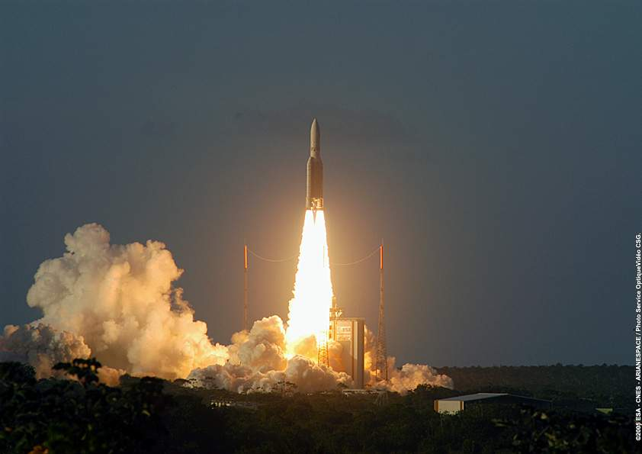
The Legacy of the Outer Space Treaty
Launcher technologies are very similar to long-range missile technology

Slide 24
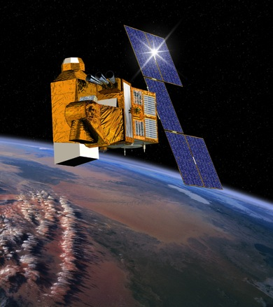
The Legacy of the Outer Space Treaty
Reconnaissance military satellites use the same technologies as civilian Earth observation satellites
The Helios 2 reconnaissance
spacecraft (France, 2004)

Slide 25
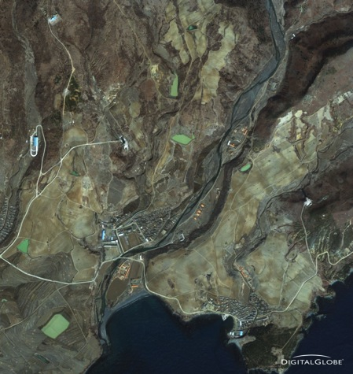
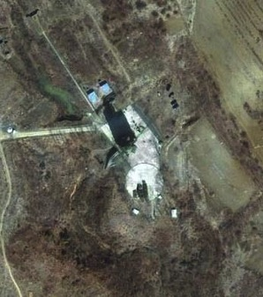
The Legacy of the Outer Space Treaty
North Korean launch pad at the Tonghae (formerly Musudan-ri) missile launch base as seen by Worldview 2

Slide 26
The Legacy of the Outer Space Treaty
2/ Applications of space systems to satisfy society’s needs include both:
« Public good » applications (meteorology, environment monitoring, civil protection, search and rescue), and
Commercial, market driven applications such as telecommunications and broadcasting, navigation services.
They require a close connection with advanced scientific research (e.g. information technology, weather forecasting and understanding climate change)

Slide 27
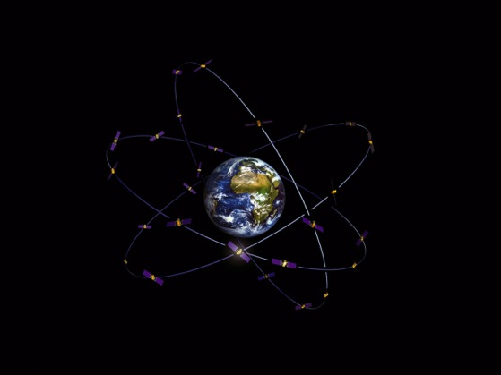
The Legacy of the Outer Space Treaty
The European Galileo satellite navigation constellation is in its deployment phase (22 satellites already in orbit, 26 by end of 2018)

Slide 28
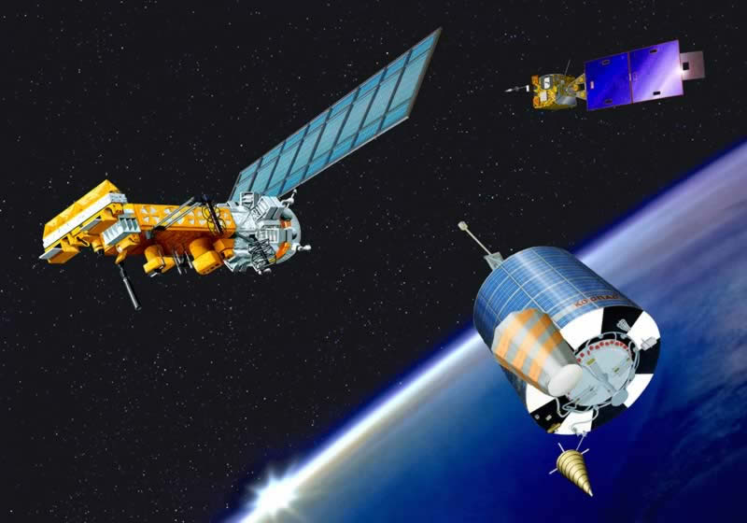
The Legacy of the Outer Space Treaty
The Search and Rescue COSPAS-SARSAT System (Canada, France, Russia, USA) is operational since 1982

Slide 29
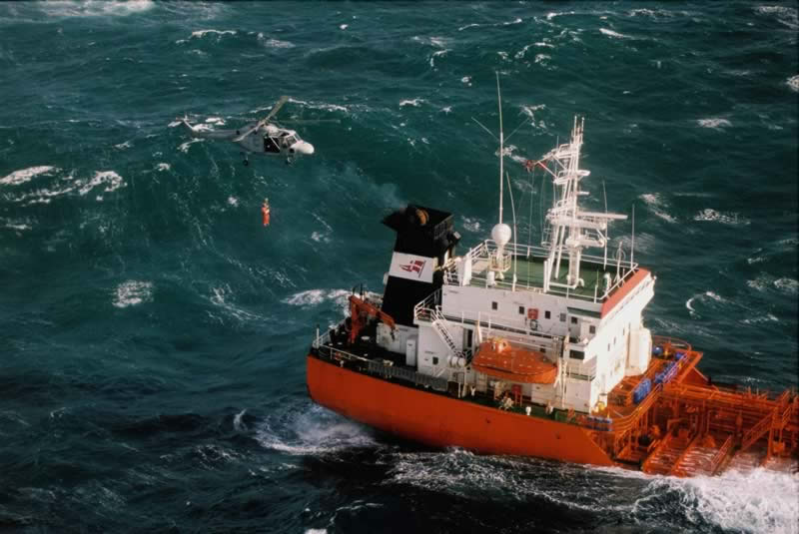
The Legacy of the Outer Space Treaty
More than 20 000 lives have been saved since it started operating.
Below, a rescue operation at sea following a COSPAS-SARSAT distress alarm

Slide 30
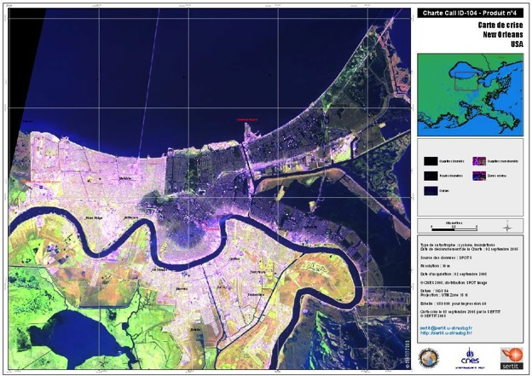
The Legacy of the Outer Space Treaty
Crisis image map, New Orleans flooding on September 2, 2005 (CNES & SERTIT)

Slide 31
The Legacy of the Outer Space Treaty
3/ Scientific research and exploration are prime drivers for space activities.
Exploration (primarily robotic) of the solar system and of the universe, discovery missions (the Moon, Mars, Venus, comets, asteroids, etc.).
Research for a better understanding of our own planet (global change, climate, atmospheric processes, oceans, land masses, earth physics).

Slide 32
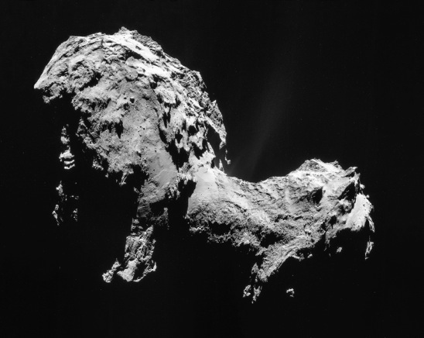
The Legacy of the Outer Space Treaty
Exploration of our Solar System: The European Rosetta/Philae mission to Comet 67P Churyumov-Gerasimenko – 14 October 2014 (Photo ESA)

Slide 33
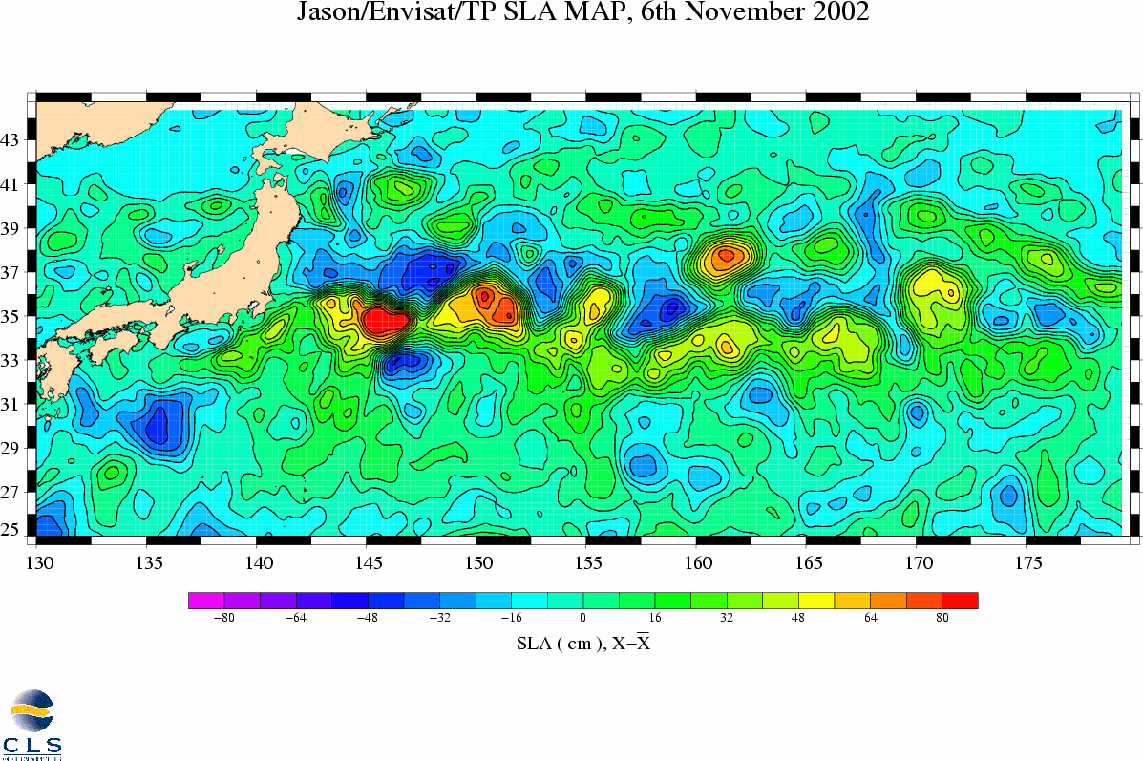
The Legacy of the Outer Space Treaty
Ocean circulation is a key to seasonal climate forecasting : Pacific ocean eddies as derived from Jason-1 and Envisat altimetry data

Slide 34
The Legacy of the Outer Space Treaty
The OST declares astronauts as envoys of mankind in outer space and deserve special protection.
Manned space programmes were mostly driven by strategic considerations during the last fifty years, i.e. political demonstration of technical capabilities (as in the Apollo program, or China more recently)

Slide 35
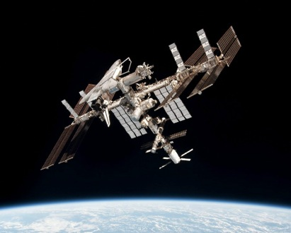
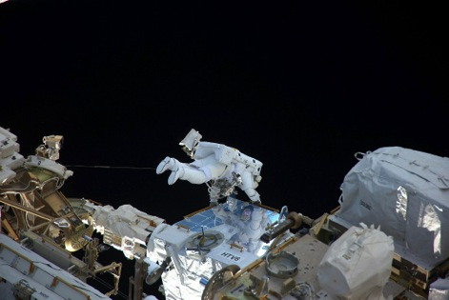
The Legacy of the Outer Space Treaty
Today, there is some disappointment with the limited spin-offs from the International Space Station, but manned space exploration will continue to inspire.

Slide 36
The Legacy of the Outer Space Treaty
The urge « to go beyond the horizon » and to explore the solar system with manned missions will remain a strong motivation.
The OST acknowledges this by repeatedly referring to “exploration and use of outer space”.
The UN Committee for the Peaceful Uses of Outer Space (COPUOS), created in 1959, does not include the word “exploration”.

Slide 37
The Legacy of the Outer Space Treaty
The success of the OST so far is generating its own challenges:
- Increased crowding in Low Earth Orbit as well as in the region around the geostationary ring creates new risks of interference and of physical collisions;
- Managing the limited orbital and radio spectrum resources is becoming a real challenge;
- Proliferation of space debris on and around certain orbits is a major concern.

Slide 38
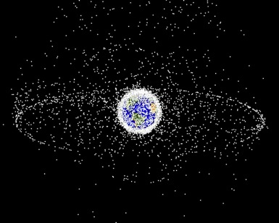
The Legacy of the Outer Space Treaty
Space debris,
some numbers :
- 5257 successful launches
from 1957 till end of 2016
- 83 launches in 2016
- 240 in orbit break-ups
- about 1200 operational
satellites, of which 500
on the GEO ring
- over 20000 objects are
tracked and cataloged by the US Space Surveillance Network:
22% are satellites, 12% rocket bodies, 10% mission-related objects, 56% fragments (up from 41% before the China ASAT test of Jan. 11, 2007)

Slide 39
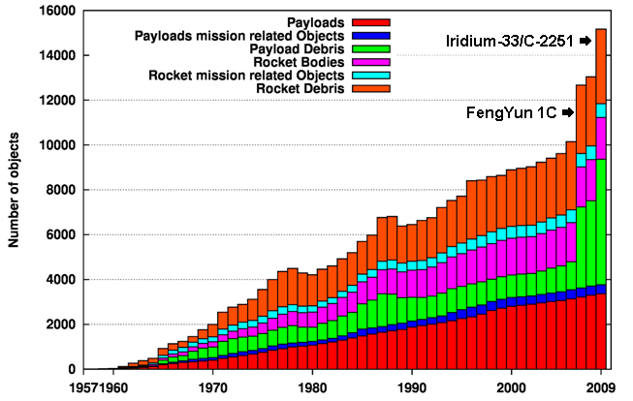
The Legacy of the Outer Space Treaty
Cataloged space objects 1957 – 2009 (source: ESA/ESOC)

Slide 40
The Legacy of the Outer Space Treaty
… and the risk of collisions between operational satellites in high inclination low Earth orbits is increasing.
A concrete example:
Conjunctions (i.e. close approaches) between the NASA Terra, Cloudsat and Aura Earth observation satellites and China’s Shijian series of satellites occur every month!
Very strict procedures have been set in place to minimize the risk of collision.

Slide 41
The Legacy of the Outer Space Treaty
There is also the risk of outer space becoming a battlefield:
- Deployment of weapons in outer space has (apparently) not taken place.
- …but ground-based weapons can be used against spacecraft in Low Earth Orbit.
- Also of concern: several highly mobile “inspection” satellites have been launched and tested in orbit during the last few years.

Slide 42
The Legacy of the Outer Space Treaty
The legacy of the Outer Space Treaty is extremely positive,
…but new international mechanisms are needed to ensure a safe and sustainable use of outer space.
Thank you for your attention

