Slide 1
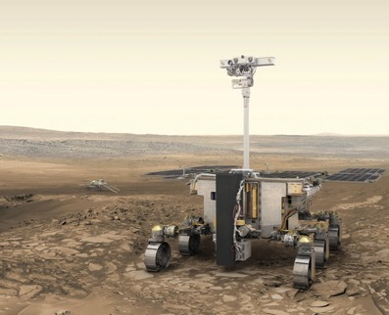
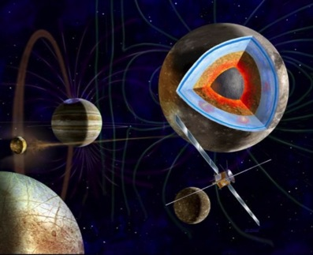
Exploration and exploitation of space
Why, how, how far have we got?
Andrew Coates
Mullard Space Science Laboratory, UCL
www.ucl.ac.uk/mssl
ESA
ESA

Slide 2

Outer space treaty (1967)
the exploration and use of outer space shall be carried out for the benefit and in the interests of all countries and shall be the province of all mankind;
outer space shall be free for exploration and use by all States;
outer space is not subject to national appropriation by claim of sovereignty, by means of use or occupation, or by any other means;
States shall not place nuclear weapons or other weapons of mass destruction in orbit or on celestial bodies or station them in outer space in any other manner;
the Moon and other celestial bodies shall be used exclusively for peaceful purposes;
astronauts shall be regarded as the envoys of mankind;
States shall be responsible for national space activities whether carried out by governmental or non-governmental entities;
States shall be liable for damage caused by their space objects; and
States shall avoid harmful contamination of space and celestial bodies.

Slide 3

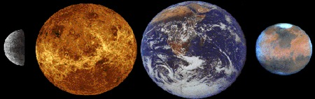
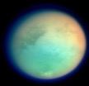
Exploration – why?
To put Earth in context with the other planets
To understand how the solar system formed
To understand why Earth is so special
To understand more about the Universe
To examine influences on the environment of the planets, e.g. from the Sun
Understand our place in the Universe
Exploration – how?
Missions like ExoMars, JUICE, Cassini…and Cluster, Solar Orbiter, JWST, Euclid
Apollo, Mir, ISS, Deep Space Gateway…

Slide 4
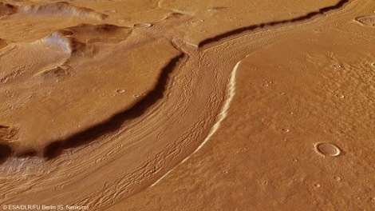
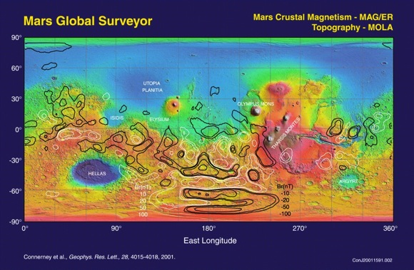
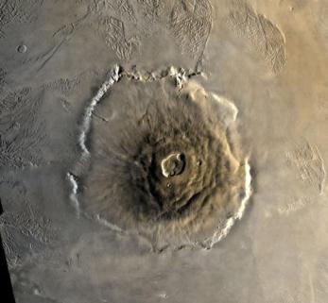
Mars 3.8 by ago
Water on surface
ESA
Magnetic field
NASA
Volcanism
Notes:
3.8 billion years ago, Mars was a very different place
- volcanic (e.g. Olympus Mons – largest volcano in the solar system)
- magnetic (in the last 10 years there has been evidence of an early global magnetic field – shown by crustal magnetization in old regions of Mars
- warm and wet (evidence of water flowing on surface from orbiter imagery and from other techniques e.g. mineral analysis from landers)

Slide 5
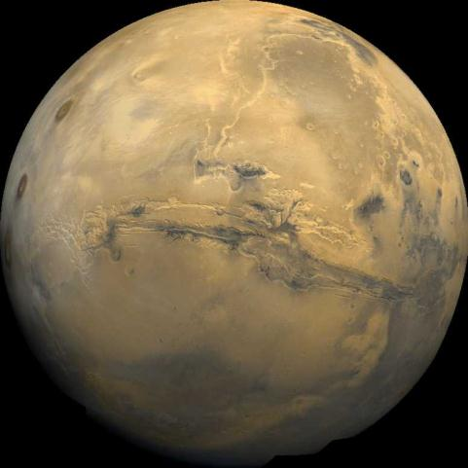
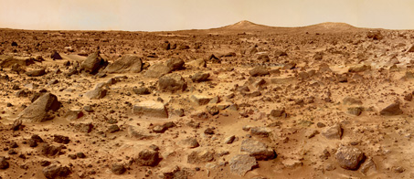
Mars now
Extinct volcanoes
No large-scale magnetic field, only remanent regions
7 mbar, CO₂-rich atmosphere
Cold, dry
NASA
NASA
Notes:
Mars now is very different –dry, relatively inactive and with a thin atmosphere

Slide 6
Requirements for life
Liquid water
Essential elements (C, H, N, O, P, S)
Source of heat
Time

Slide 7



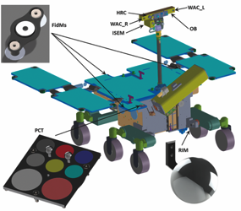
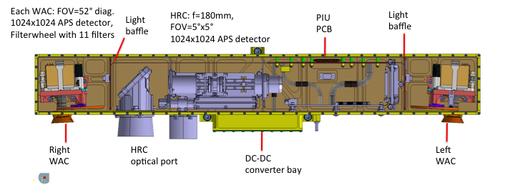





ExoMars 2020 PanCam
PI: Andrew Coates MSSL-UCL
PM: Mary Carter MSSL-UCL
International team including DLR/OHB (D), TAS (CH), Joanneum Research (A), Aberystwyth (UK) + International Science Team
PanCam includes:
Wide Angle Camera (WAC) pair, for multi-spectral stereoscopic panoramic imaging, using a miniaturised filter wheel
High Resolution Camera (HRC) for high resolution colour images
Pancam Interface Unit (PIU) to provide a single electronic interface
PanCam Optical Bench (OB) to house PanCam and provide planetary and dust protection
‘Small items’: PanCam Calibration Target (PCT), Fiducial Markers (FidM)
Related hardware: Rover Inspection Mirror (RIM) to provide radiometric and geometric calibration checks and to observe areas not directly visible by WACs or HRC
Notes:
PanCam is led by MSSL and has a strong international team – Germany, Switzerland, Austria as well as UK and other science team members
It is an extremely powerful scientific camera system for Mars – and must survive extreme temperatures (about 0°C during the day and -100-120°C at night
The wide angle cameras are 50cm apart and provide stereo reconstruction better than the human eyes

Slide 8
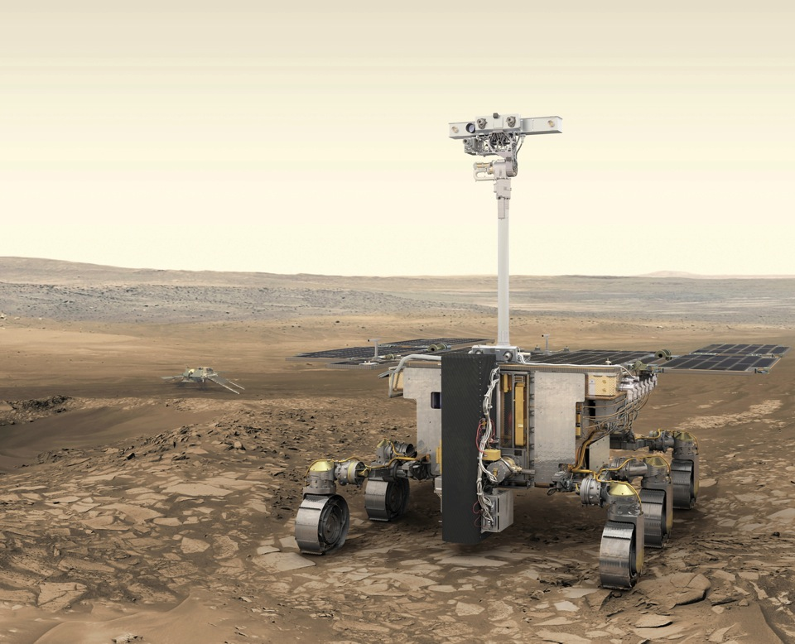
Future missions to Mars
ESA-Russia
  Trace gas orbiter (2016)
  ExoMars rover (2020)
NASA
  InSight (2018)
  Mars 2020 (2020)
UAE
  Orbiter (2020)
China
  Orbiter, rover (2020)
Others e.g. Space X??

Slide 9
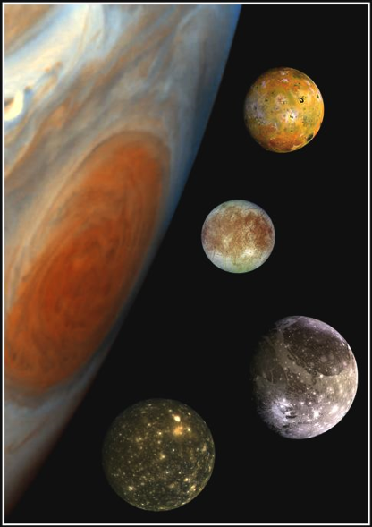
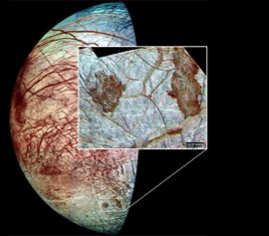
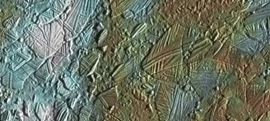
Europa’s frigid, young surface
NASA
Galilean satellites
NASA

Slide 10
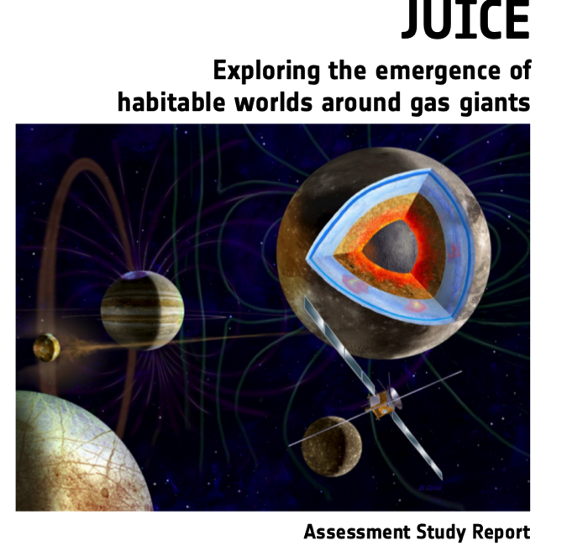
ESA mission
Launch: 2022

Slide 11
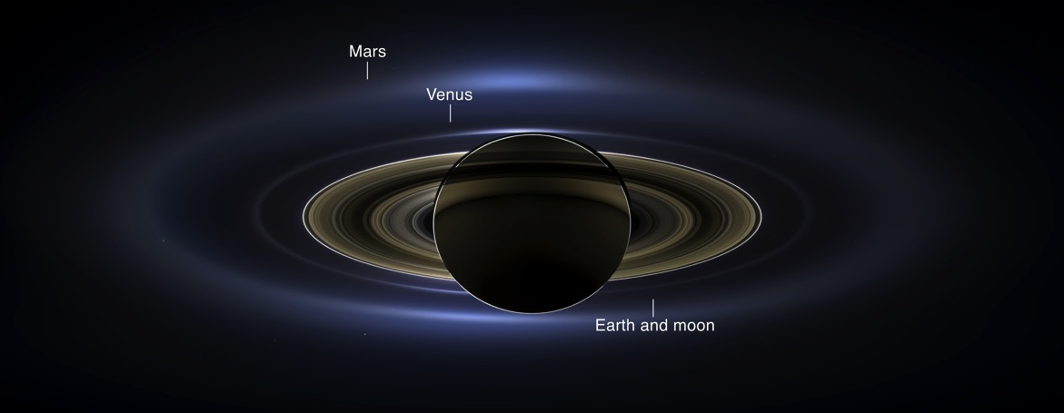
NASA/JPL/SSI

Slide 12
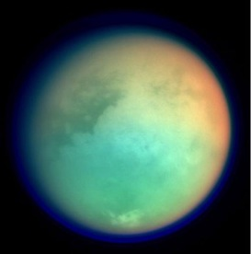
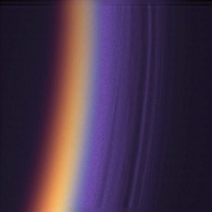
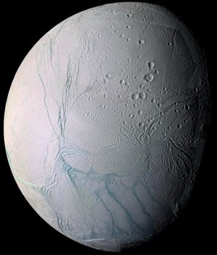
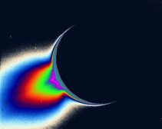
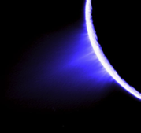
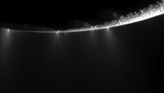
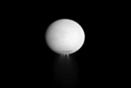
Saturn’s moons
Titan
Enceladus
(a)
(b)
(c)
(d)
NASA/JPL/Space Science Institute
Composite from Coates, 2012

Slide 13
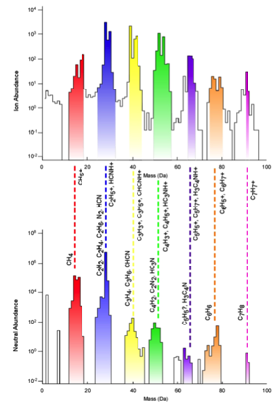
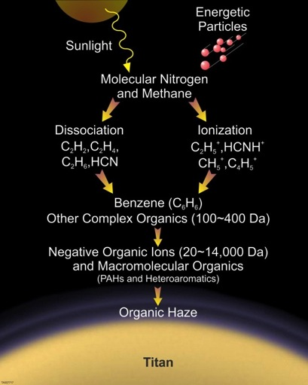
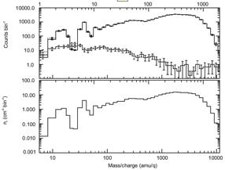
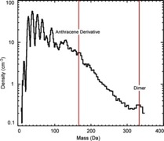
Titan’s atmosphere:
a rich chemical environment revealed by Cassini
Escape mass 1,16,28
Unexpected heavy negative ions: Coates et al, 2007a, 2009, 2010, Sittler et al, 2009, Vuitton et al, 2009, Michael et al 2011, Lavvas et al, 2012, Wellbrock et al, 2013, Desai et al 2017
Escape – Coates, et al 2012
Heavy neutrals and positive ions: Waite et al, 2007
Adapted from Waite et al 07
Notes:
Waite et al., Science, 2007.

Slide 14


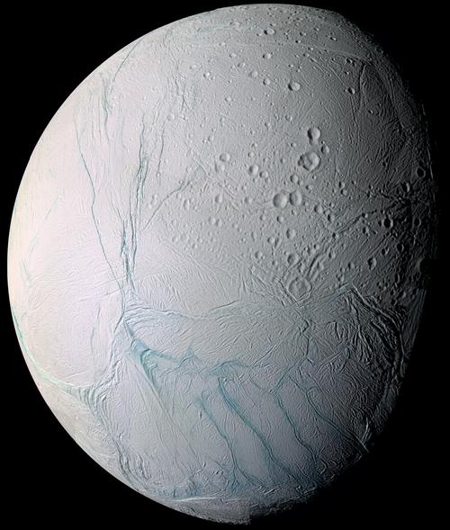

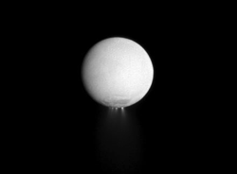
(a)
(b)
(c)
(d)
Enceladus
- plumes
- sodium
- silicates
- hydrogen
Titan
- prebiotic chemistry

Slide 15
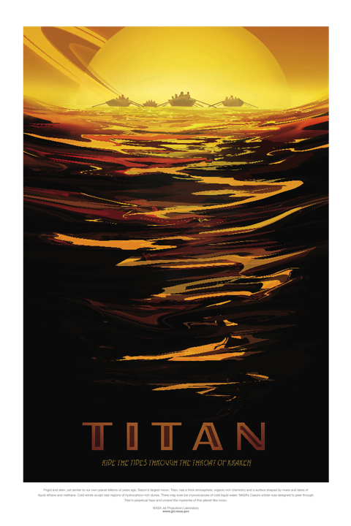

NASA/JPL

Slide 16
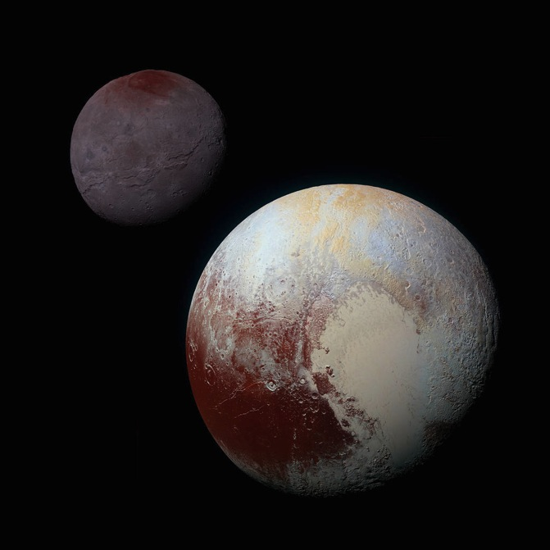
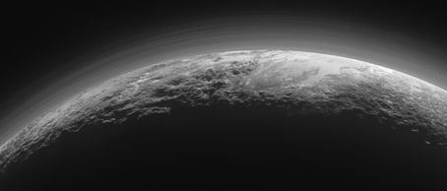

Pluto and Charon
Courtesy NASA/JHUAPL/SwRI

Slide 17

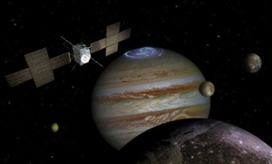
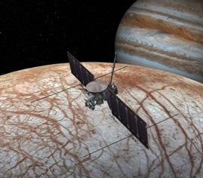
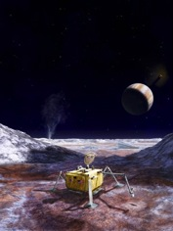
Missions looking for habitable conditions
We have a scientific imperative to gain answers to the question about whether life exists beyond Earth before potentially contaminating missions
ESA-Russia
ExoMars 2020
ESA JUICE
NASA Europa Clipper
NASA Europa Lander

Slide 18
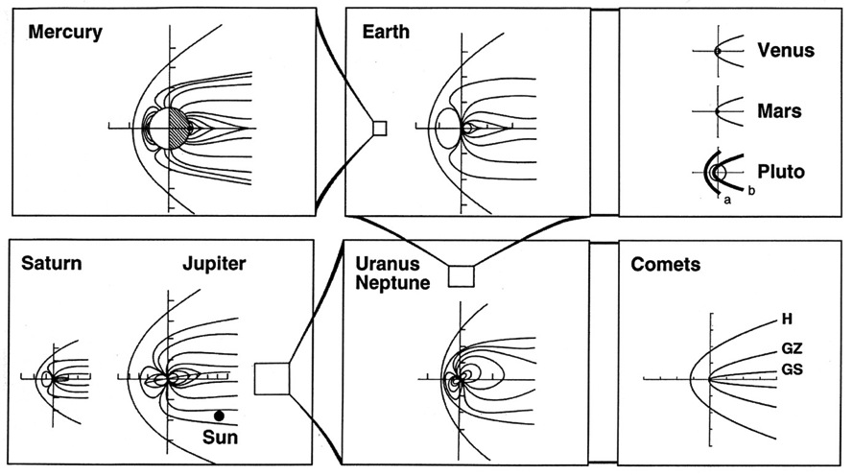
Solar wind interaction regions
Current and planned robotic exploration
Magnetized
Unmagnetized
Venus Express, to 2014
Many missions
e.g. Cluster
Mars Express, to 2020
MSL, Insight (18), 2020
ExoMars -TGO 16, rover 20
Messenger, 2011
BepiColombo, 2025
Moon
Deep Space Gateway
Trump initiative this week
New Horizons, 2015
Cassini, to 2017
JUNO, 2011
JUICE, 2030
Rosetta, 2014-16
Asteroids
Dawn, 2011-15, Osiris-REX 18, Hayabusa 2 18

Slide 19
Life elsewhere in the solar system?
 | Mars | Europa | Ganymede | Callisto | Titan | Enceladus
Liquid water | 3.8 BY ago | Under icy crust, lower boundary silicate | Under icy crust, lower boundary ice | Under icy crust, lower boundary ice | Sub-surface | Sub-surface, source of plumes
Essential elements (CHNOPS) | 3.8 BY ago, Current – ExoMars | JUICE | JUICE | JUICE | Cassini | Cassini
Source of heat | Primordial 3.8 BY ago | Tidal | Tidal | Tidal | Tidal | Tidal
Time | Same time as terrestrial life | Probably (JUICE) | Probably (JUICE) | Probably (JUICE) | Probably (Cassini) | Maybe (Cassini)
Conclusion | 3.8 BY ago? (ExoMars) | Possible (JUICE) | Less likely (JUICE) | Less likely (JUICE) | Later? (Cassini) | Possible (Cassini)

Slide 20
Planetary Exploration
Object | Stage * | Future missions
Mercury | 1 | ESA BepiColombo
Venus | 1,2,3 | None
Mars | 1,2,3 | ESA/Russia (ExoMars TGO, 2020 rover), NASA (Insight, Mars 2020), Japan (MMX), UAE, China, India
Jupiter | 1,2,(3) | ESA JUICE, NASA Europa Clipper
Saturn | 1,2,3 | None
Uranus | 1 | None
Neptune | 1 | None
Pluto | 1 | None
* Stages: 1=flyby, 2=orbiter, 3=lander, 4=sample return

Slide 21
Exploration of Sun and small bodies
Object | Stage * | Future missions
Magnetosphere | 1,2,NA | ESA (SMILE)
Sun and solar wind | 1,2,4 | ESA Solar Orbiter, NASA Parker Solar Probe
Comets | 1,2,3,(4) | New Horizons (KBO 2014 MU69)
Asteroids | 1,2,(3),4 | NASA (Dawn, Osiris-REX, Psyche, Lucy), Japan (Hayabusa 2)
Moon | 1,2,3,4 | Chandrayaan-2, China, Deep Space Gateway?
* Stages: 1=flyby, 2=orbiter, 3=lander, 4=sample return

Slide 22
Astrophysics missions
Object | Future missions
Extrasolar planets | ESA (Plato, CHEOPS), NASA (TESS)
Astrophysics | ESA (Euclid, Athena), NASA-ESA (JWST), NASA (WFIRST)

Slide 23
Exploration – how far have we got?
Initial exploration of many objects in the solar system with non-crewed missions
Apollo missions, low Earth orbit with humans
Starting with non-governmental exploration – Google Lunar X prize, Space X/Elon Musk,…

Slide 24
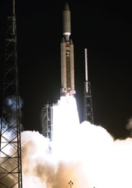
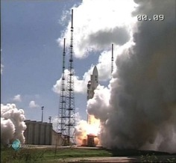
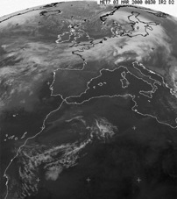
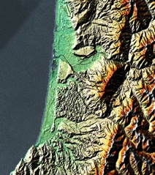
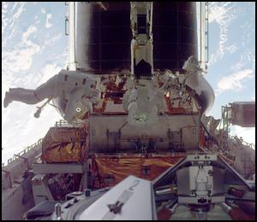
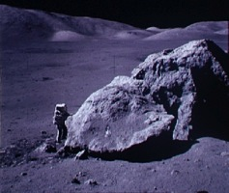
Exploitation – why?
Global coverage
Business opportunities
Exploitation – how?
Technology development
Meteorology
Remote sensing of Earth
Telecommunications
Navigation
Military
Manned exploration
Mining?
Space debris removal?

Slide 25
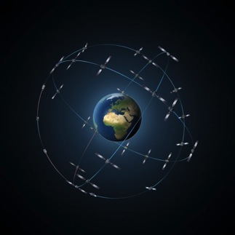
Exploitation – how far have we got?
Weather satellites
Land use, climate change
Lucrative communications market
GPS, Galileo
Surveillance, arms monitoring
Moon 1969-72, LEO
Luxembourg interest
RemoveDEBRIS mission, 2018
ESA-P. Carril

