Slide 1

Food Security and the potential role for space science – Part 2
Mark Jarman
Head of Earth Observation
“To Innovate for a better world,
empowered by satellites”

Slide 2



Food Security and the potential role for space science
Sound agronomy and crop science
Enabling public policies
Innovative agricultural technologies

Slide 3
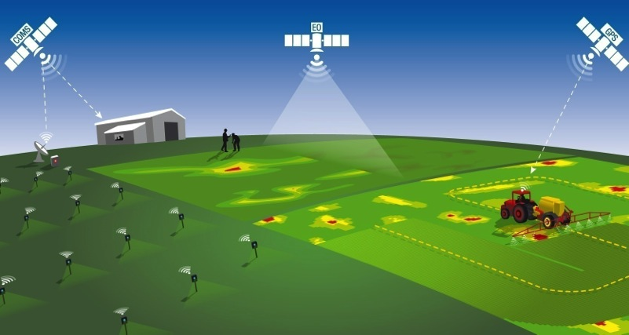
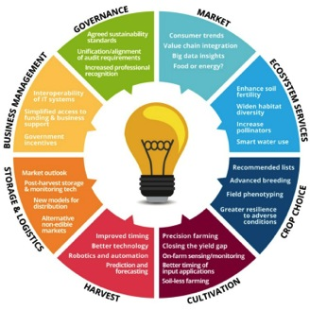


The importance of Satellites for agriculture
Satellites enable and enhance agricultural applications in many different ways. They provide positioning information, they can deliver wide-scale observation on a frequent, regular basis and they facilitate communications.
Weather forecasting
Crop yield estimation
Harvest forecasting and management
Agri-environmental assessment
Land Use and change
Management planning
Field boundary management
Illicit crop management
Compliance and certification
Crop identification
Variability Mapping
Growth Stage Monitoring
Irrigation Management
Seed density optimisation
Soil mapping
Crop re-growth monitoring
Fertilizer application management
Crop health management
Crop damage assessment
Invasive species monitoring
Source – AgriTech East

Slide 4

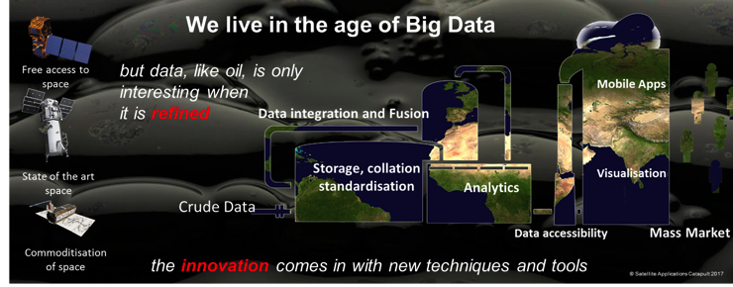




Why to get excited by space….
Neuromorphic Chips
Smart Analytics
Semantic Querying
New constellations

Slide 5
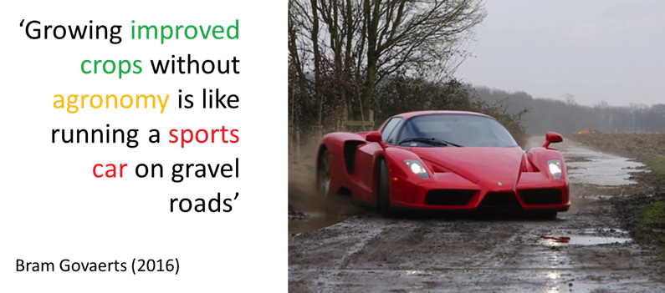
Need to exploit technology correctly

Slide 6

Solving a puzzle
Farmers are always working on solving puzzles to maximise output….
‘Make every Hectare count’
“Flat rate inputs onto variable fields can only produce variable returns”
“If it is variable and we can measure it, the aim is to correct and balance it”
Farming pieces
Policy pieces
Technology pieces

Slide 7
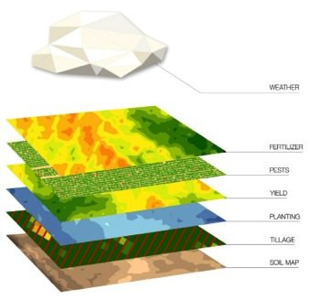
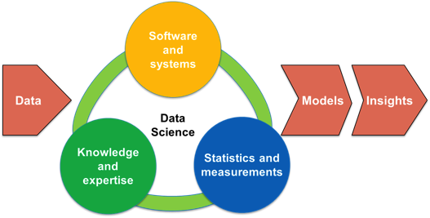
Data integration, modelling and understanding
When data related to agriculture and food is made open or shared more easily, more can be done by scientists, governments, industry, NGOs and farmers to improve agricultural outcomes.

Slide 8









Global initiatives
International Partnership Programme (IPP)

Slide 9
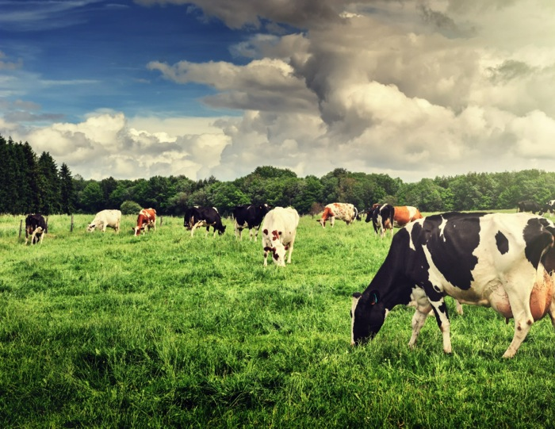
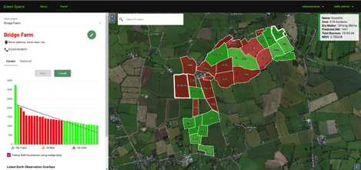
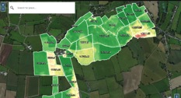
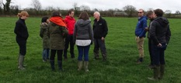
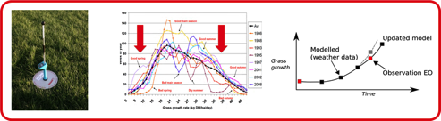


Case Study: Improving grassland nutrition and grazing management
Working with the Agri-EPI Centre and Cranfield University, a Pilot research project within the 2017 growing season aimed at exploiting satellite Earth observation (EO), weather and field data alongside other emerging technologies to support the precision management of grassland agriculture.

Slide 10
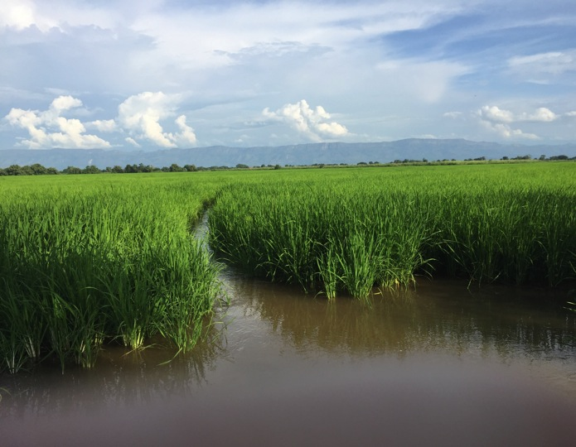
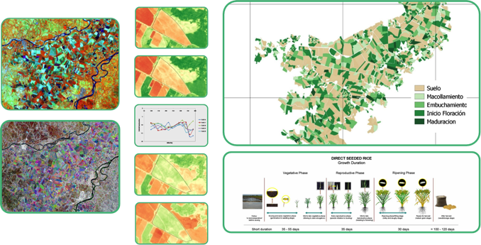




Case Study: Monitoring Colombian rice production
  Rice federation (Fedearroz) required quick identification of fields displaying variability indicative of crop stress (drought, disease, and pest damage) to help target field investigations and enable intervention.
  Satellite data used to monitor field conditions and crop development/ stages through the crop growing season
  Tool created tool highlight variations in levels of rice vigour to inform field visits

Slide 11
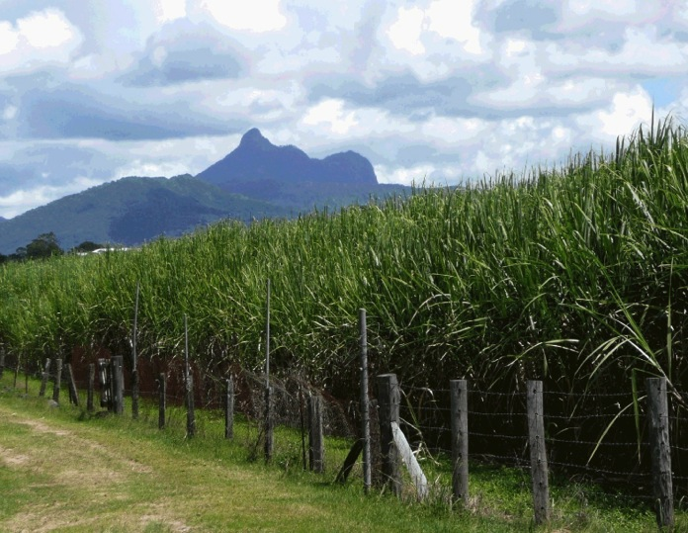
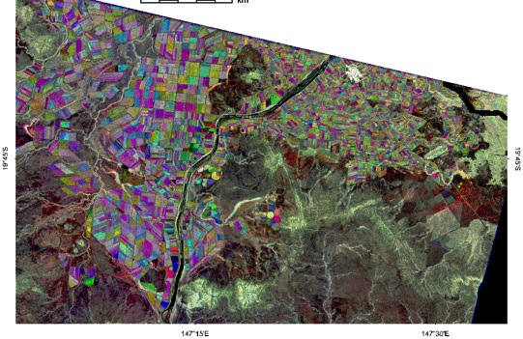
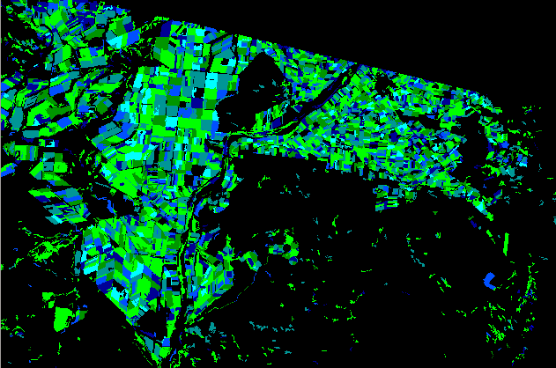
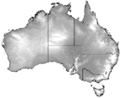
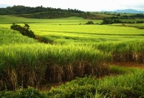
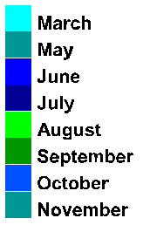

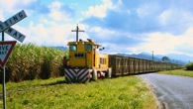
Case Study: Optimising Australian Sugar Cane harvest
Supporting sugar cane mills to use satellite data to assess sugar cane growth stage and to aid harvest date estimation and support logistics planning
N
Multi-temporal variation of sugarcane and Sentinel-1
Urban
River
Sugarcane
Irrigation
circles
Vegetated creek bed
Open farmland
Hills
Data © ESA
Image © CSIRO 2016
Multi-temporal smoothed VH scene (Red = May, Green = August, Blue = November 2015)
- Sugarcane shows up due to its high multi-temporal variability

Slide 12

Food Security – A global challenge – A global opportunity
Manage More with Less
Work Smarter not Harder
Sound agronomy and crop science
Enabling public policies
Innovative agricultural technologies

Slide 13

Thank You!
Never has the agricultural sector looked so attractive to other industries
Mark.Jarman@sa.catapult.org.uk
@SatAppsCatapult
www.sa.catapult.org.uk/

