Slide 1
Security of Space Assets
Mark Roberts
BD Director, International Defence & Security, and Space

Slide 2
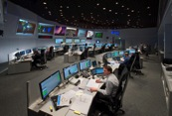


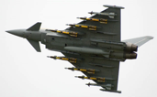
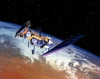

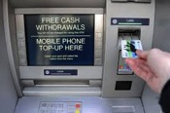
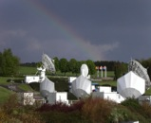
What Are We Talking About?
  Space Assets
  In terms of the threat Space has 5 components:
  Orbiting assets
  Ground stations
  Command and Control
  Users
  Information
  Photo: ESA/ J. Mai
  Photo: Phonesworld
Threats
  Physical
  Cyber
  Debris
  Photo: ESA
  Photo: Flightglobal
  Image: NASA
  Photo: How is Works
  Photo: ESA - D. Galardini

Slide 3

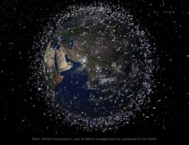
Definitions?
Cyber
  Any identified effort directed toward access to, exfiltration of, manipulation of, or impairment to the integrity, confidentiality, security or availability of data, an application, or a federal system, without lawful authority.
  (Cybercrime – DHS Mar 2010)
Space Debris
All the inactive, manmade objects, including fragments, that are orbiting Earth or re-entering the atmosphere
(ESA Space Debris Brochure 2017)

Slide 4
Cyber - ‘A Day Without Space?’
Degradation, Disruption or Denial of:
  Transportation, Banking, Power, Telecommunications (incl Mobiles and the Net), News Services, Air, Sea and Land Navigation, Distress Detection, Blue Light Services...........
  GPS/Timing
  Business concerns: reputation, liabilities, the business of doing business
  Increasingly, our way of life!
  But what about Space Destruction?
  A conjunction/collision scenario?
    The Kessler Syndrome
  Is this a Cyber threat?
  Is this a real threat?
  Image: ESA

Slide 5
Open Source Space Incidents
1998 US-German ROSAT satellite disabled
2003 Telstar 12 jammed
2005 Two telecommunications satellites jammed
2007 Successful ASAT test
2009 Homemade equip used to ‘hijack’ UHF freqs
2010 Satellite broadcasts jammed
c. 2011 Terra EOS & Landsat 7 experienced cyber interference
‘hackers “achieved all steps required” to assume control of the spacecraft’
2011 IntelsatONE identified 300,000 denial-of-service attacks
2014 US National Oceanographic and Atmospheric Information
denied for 48 Hours
Sources: Red Lines in Outer Space”, Kleiman & McNeil, March 2012
Report for Congress “China’s Anti-Satellite Weapon Test”, Kan, 2007 Nov 2011 Report for Congress by U.S.–China Economic and Security Review Commission
Bulliten of Atomic Scietists, 2016

Slide 6

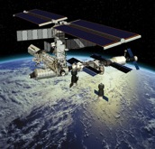
Cyber Threat to Space - What’s New?
Space and Cyber are two sides of the same evolutionary ‘coin’
The weapons are knowledge and skills, not tech or systems?
Strategic Balance:
- Red lines?
Legal - Day 0, Day 1, Day ½?
Speed:
  Decisions in nanoseconds?
  Pre-auth?
  Automation of war?
Asymmetric!
Critical importance of a joint approach
Image: ESA - D.Ducros

Slide 7




Securing the Future
Upstream - Building a Cyber Resilient Spaceport?
      Identify – Assess – Review – Adopt – Evolve
Downstream - Securing Our Way Life
      Same as Upstream, but….
      Look out a long way and learn from the past
      Secure the system of systems
Cyber Resilience:
      Disclosure
      Risk Assessment
      Cultural Challenges
      Technical Challenges
      Legacy Systems

Slide 8
Debris!
Number of rocket launches since the start of the space age in 1957:
About 5250
Number of satellites these rocket launches have placed into Earth orbit:
About 7500
Number of these still in space:
About 4300
Number of these still functioning:
About 1200
Number of debris objects regularly tracked by the US Space Surveillance Network and maintained in their catalogue:
About 23 000
Estimated number of break-ups, explosions and collision events resulting in fragmentation:
More than 290
Total mass of all space objects in Earth orbit:
About 7500 tonnes
Number of debris objects estimated by statistical models to be in orbit:
29 000 objects >10 cm
750 000 objects from 1 cm to 10 cm
166 million objects from 1 mm to 1 cm
  Source: ESA Jan 2017

Slide 9
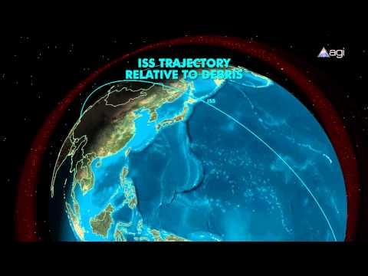
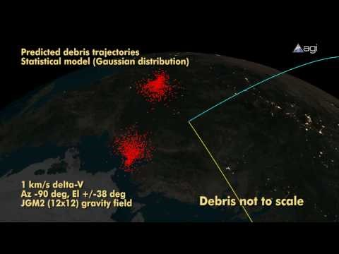
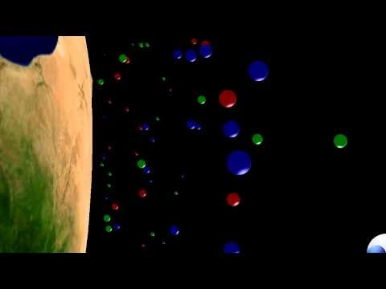
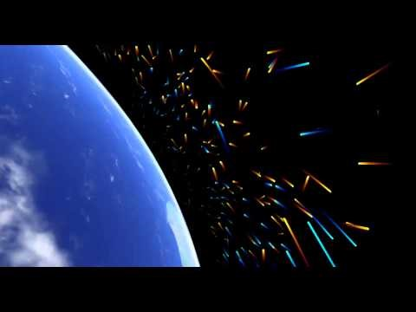
The Debris Problem
Chinese 2007 ASAT Missile Test - Feng-Yun 1C
Iridium 33 & Cosmos 2251 Conjunction
ISS – 400 km
Blue: Cosmos 2251, Green: Iridium 33, Red: Feng-Yun 1C
ENVISAT – 770km SSO

Slide 10
The Debris Problem - Removal
Some Methods
Tug Satellites
Electro Dynamic Tethers
Laser Brooms
Solar Sails
Space Nets and Collectors
Removal
Numerous proposed solutions
But, are they weapons?
Needs:
  Disclosure
  Risk Assessment
  Technical Challenges
  Cultural Challenges
Prevention
Treaties
  OST
  International Code of Conduct
  2017 EU Principles of Responsible Behaviour in Outer Space
Space fairing Nations Lead by Example

Slide 11
Security of Space Assets
Cyber
Design in Resilience
Future looking / what if? scenario testing / understanding the threat/risk
Self healing / effective intervention by the operator
‘Harden’ the infrastructure
Consider the reversionary modes of operations
Debris
Behave responsibly – we will all lose
Meet the need to de-orbit at the end of the mission
Fund the clean up
Policy / Treaties / Law
Define responsibility for achieving and verifying cyber survivability
Define responsibility for threat mitigation / response
Keep going!

Slide 12
Thank You
Mark Roberts
+44 7834 507646
Mark.roberts2@atkinsglobal.com

