Slide 1
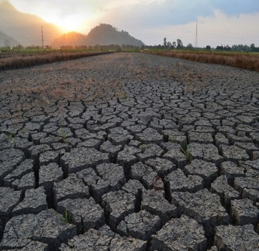
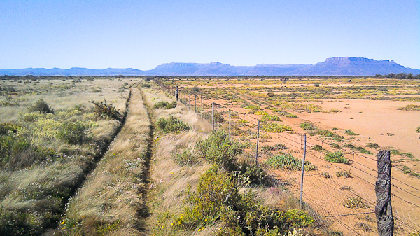
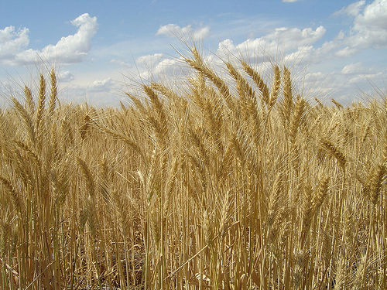
Food Security and the potential role for space science
Some thoughts from a worried observer
Dr. Conor Walsh

Slide 2
Outline
Introducing Important trends in food security.
Future Stresses.
Role of Space Science.
  From the perspectives of an environmental scientist.

Slide 3
So far so good..
(Kg/person/Year) FAO 2013
The growth in production of cereals associated with demand based issues.
100-70% increase by 2050.
Supply-side issues based on growing intensification.
Source: FAOSTAT

Slide 4
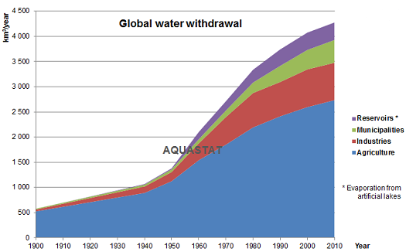
But Wait…what about resource rwquirements
Source: Esriman, J., Sutton, M. and Winiwarter, W. (2008). How a Century of Ammonia Synthesis Changed the World. Nature Geoscience, 1, pp. 639-639. http://nature.com.articles.ngeo325. Accessed on 29th October 2017.
Source: AQUASTAT

Slide 5
So what about food security?
Cereal import dependency is a useful statistic.
  Ratio between imports and domestic consumptive demand.
Very complex
  Many big producers also big consumers.
  Changes in trade may not be proportional to changes in production.
Source: FAOSTAT

Slide 6
Grain Importers (FAO)
1975 |  |  | 2013
Country | Trade (Mt) | % | Country | Trade (Mt) | %
Japan | 19 | 11% | Japan | 25 | 6%
USSR | 17 | 10% | China | 21 | 5%
Germany | 10 | 6% | Saudi Arabia | 16 | 4%
Netherlands | 9 | 5% | Egypt | 16 | 4%
United Kingdom | 8 | 5% | China, mainland | 15 | 4%
India | 8 | 5% | Republic of Korea | 14 | 4%
Italy | 7 | 4% | Mexico | 14 | 3%
China | 7 | 4% | Iran (Islamic Republic of) | 11 | 3%
Belgium-Luxembourg | 5 | 3% | Netherlands | 11 | 3%
Rest of World | 75 | 46% | Rest of World | 258 | 64%
Total | 164 | 100% | Total | 400 | 100%

Slide 7
Grain Exporters
1975 |  |  | 2013
Country | Trade (Mt) | % | Country | Trade (Mt) | %
USA | 74 | 6% | USA | 64 | 17%
Canada | 16 | 5% | France | 34 | 9%
France | 13 | 4% | Argentina | 29 | 7%
Australia | 11 | 4% | Brazil | 29 | 7%
Argentina | 8 | 4% | Ukraine | 27 | 7%
Netherlands | 5 | 4% | Canada | 25 | 6%
USSR | 4 | 3% | Australia | 25 | 6%
South Africa | 4 | 3% | India | 24 | 6%
Thailand | 3 | 3% | Russian Federation | 19 | 5%
Rest of World | 22 | 64% | Rest of World | 111 | 29%
Total | 160 | 100% | Total | 386 | 100%
Notes:
Exports becoming more concentrates as imports more diverse.

Slide 8
Where will the impacts be in +4C by end of century?
Regions in the lower latitudes anticipated to be more impacted if emissions not reduced.
Some areas might benefit through enhanced land suitability.
Rosenzweiga et al (2014) Assessing agricultural risks of climate change in the 21st century in a global gridded crop model inter-comparison
Median yield changes (%) for RCP8.5 (2070–2099 in comparison to 1980–2010 baseline)

Slide 9
Scenario: Potential Climate Change impacts
2C: In a world with modest climate change impacts maintained per capita consumption and expanding irrigation area.
  Population growth SSP 1.
4C: In a 4 °C world where Egyptian yields decrease 20% by 2050 with increasing consumption, import dependencies increase.
  Population growth SSP 5.
Yield Impacts extrapolated taken from: Yates, D.N. and Strzepek, K.M., 1998. An assessment of integrated climate change impacts on the agricultural economy of Egypt. Climatic Change,38(3), pp.261-287.
Source: own calculations

Slide 10
Negative Emissions necessary by 2050!!

Slide 11
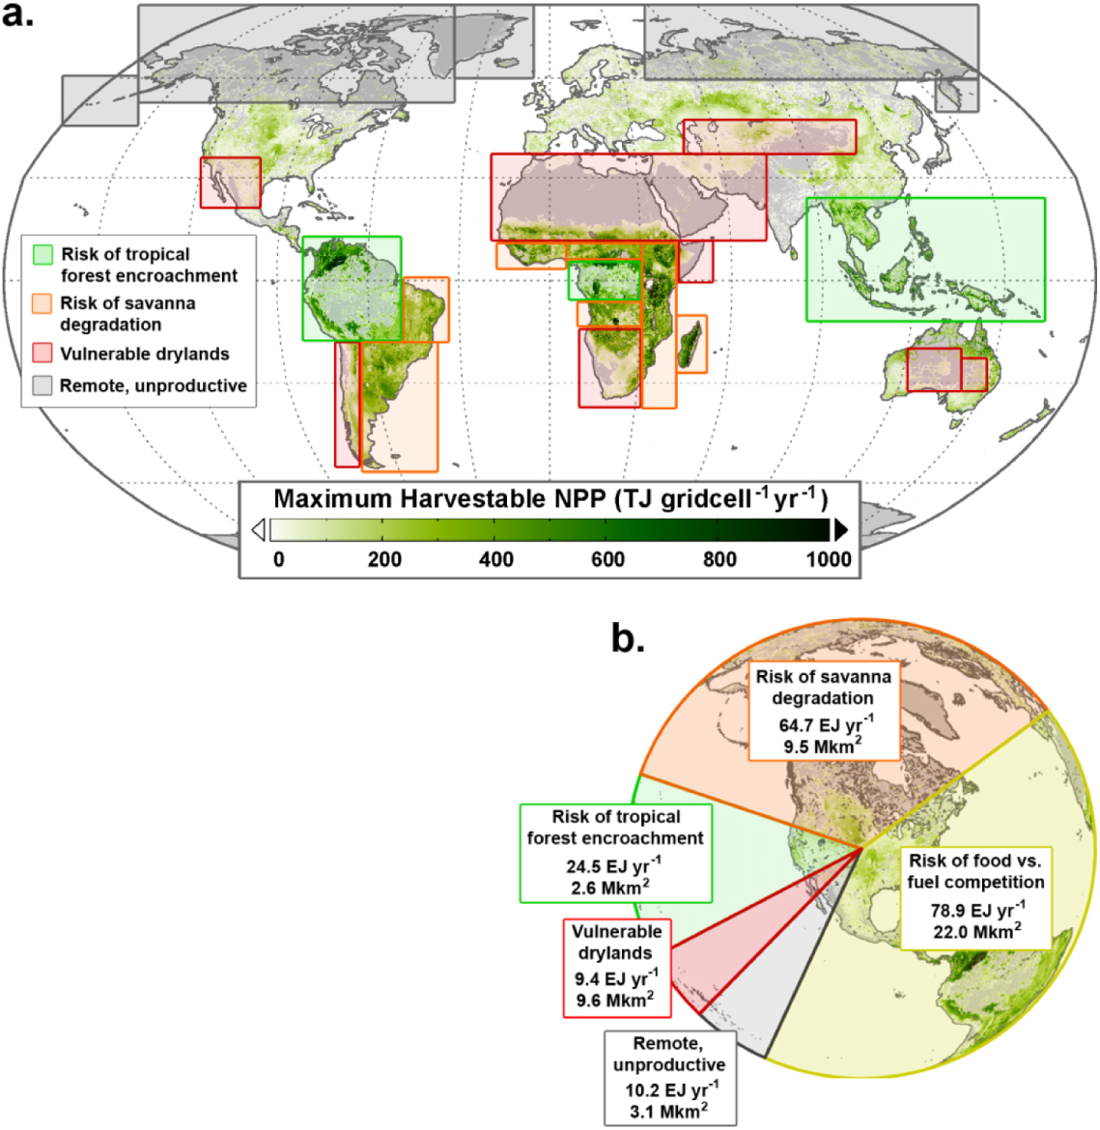
Map of the biophysical maximum biomass production (≈190 EJ yr⁻¹) that might be generated from the 4.7 billion hectares of the world's vegetated land outside denser forests, croplands, urban areas and wilderness, outlining selected potential trade-offs and risks.
Helmut Haberl et al 2013 Environ. Res. Lett. 8 031004 doi:10.1088/1748-9326/8/3/031004

Slide 12
My 2c worth on the role of space science…
High Uncertainty on regional disparities in
Extent of vulnerabilities to climate change.
Potential of expansion of productivity.
Vital for understanding Food/Water/Energy/Land Nexus

Slide 13
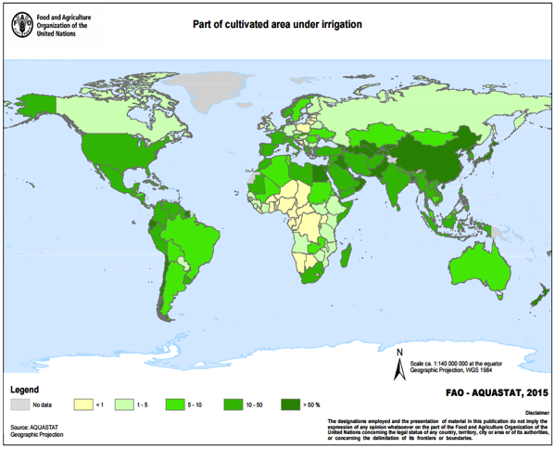
Regions like Africa seen as being key.
Montepelier Panel. Sustainable intensification: a new paradigm for african agriculture. London: Agriculture for Impact. 2013.

Slide 14
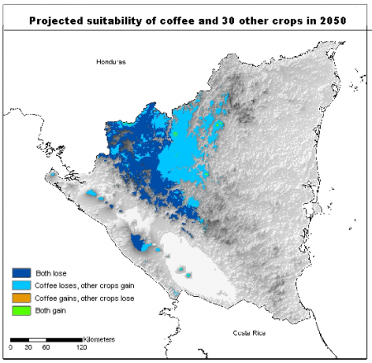
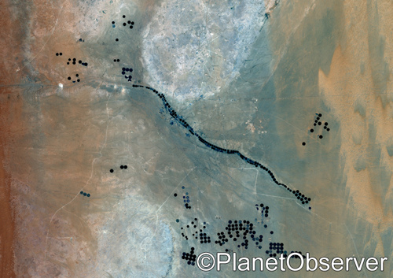
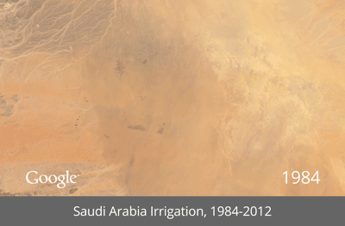
Satellite data can help verify models of climate impact/adaptation or demonstrate stress over time
Source: CIAT

